Slide 1
CMPE351 LAB4
DATABASE RELATIONSHIPS &
MYSQL WORKBENCH

Slide 2
Database Relationships
We will learn how to work with multiple tables that have relationships with each other.
First, we will cover some key concepts
Then will discuss JOIN queries in detail.

Slide 3
Relationship Types
One to One relationships
One to Many and Many to One Relationships
Many to Many Relationships
Self Referencing Relationships

Slide 4
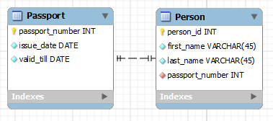
1-1 relationship:

Slide 5
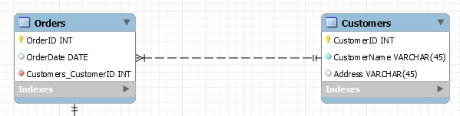
1-n (or n-1) relationship:

Slide 6
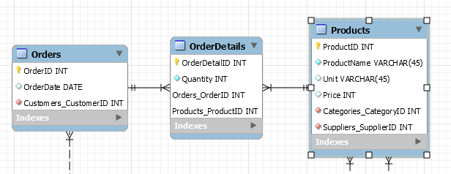
n-n relationship:

Slide 7
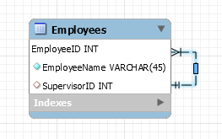
Self referencing relationship:

Slide 8
JOIN Queries
Cross Joins
Inner Joins
Left/Right (Outer) Joins
Full(Outer) Joins
We will also learn about the ON clause and the USING clause.

Slide 9
Cross Join
SELECT * FROM Categories JOIN Products;
SELECT * FROM Categories, Products;
The result is a Cartesian product of the tables Categories and Products. It means that each row from the first table is matched with each row of the second table.
Since Categories had 8 rows and Products had 77 rows, we ended up getting a result of 616 rows.
This type of result is usually not useful. We will look at the other JOIN types.

Slide 10
Inner Join
With this kind of JOIN query, the tables need to have a matching column name. In our case, both the tables have the CategoryID column. So, MySQL will join the records only when the value of this column is matching on two records.
SELECT * FROM CATEGORIES JOIN PRODUCTS
ON Categories.CategoryID = Products.CategoryID;
SELECT * FROM CATEGORIES JOIN PRODUCTS
USING (CategoryID);
We can use USING clause if a column has the same name on both tables as in our example

Slide 11
Left/Right (Outer) Join
In these queries, if there is no match found from the second table, the record from the first table is still displayed.
SELECT * FROM Categories LEFT OUTER JOIN Products
USING (CategoryID);
LEFT JOIN is also useful for finding records that do not have relationships. For example, we can search for customers who have not placed any orders.
SELECT * FROM Customers LEFT OUTER JOIN Orders
USING (CustomerID)
WHERE Orders.OrderID IS NULL;

Slide 12
Full (Outer) Join
A full outer join is a combination of a left outer and right outer join.
It returns all rows in both tables that match the query's where clause, and in cases where the on condition can't be satisfied for those rows it puts null values in for the unpopulated fields.

Slide 13
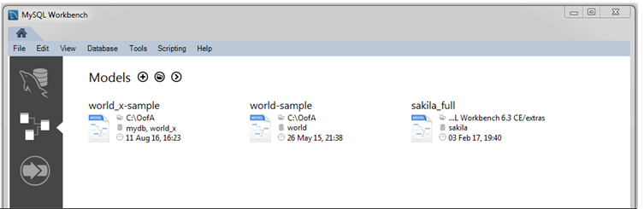
MYSQL WORKBENCH
Open MySQL Workbench on your computers
Click here to create new model

Slide 14
Main Editor Window
Study the documentation in the links below and try to understand the editor and its tabs.
https://dev.mysql.com/doc/workbench/en/wb-table-editor-main-window.html
https://dev.mysql.com/doc/workbench/en/wb-table-editor-columns-tab.html
https://dev.mysql.com/doc/workbench/en/wb-table-editor-foreign-keys-tab.html

Slide 15
Creating tables and relationships
Then try to create tables and relations on w3schools sample database using Workbench
https://dev.mysql.com/doc/workbench/en/wb-using-table-tool.html
https://dev.mysql.com/doc/workbench/en/wb-relationship-tools.html
https://dev.mysql.com/doc/workbench/en/wb-relationship-editor.html
Pay attention to the cardinality(one-to-many, many-to-many,etc.) of the relationships and primary/foreign keys of the tables related to each other.

